Slide 1
My Role in
Mandated Reporting:
An Overview for Monterey County

Slide 2


Agenda
Welcome and Introductions
Who are Mandated Reporters?
Child Abuse Mandated Reporter Training (mandatedreporterca.com)
Overview of CPS Reporting Laws
Types of Child Abuse
How Do I (Know if I Should) Make a Report?
What’s Next: Referral Process and Cross Reporting
Impact on the Mandated Reporter
Wrap-Up and Closing

Slide 3

Introductions
NAME – place you were born
Your roll and the school, agency, area in Monterey County do you serve?
What is one question you hope to get answered from this training?
How many years have you been a Mandated Reporter?
Have you ever called the H/L to make a report?

Slide 4
Learning Objectives
At the end of the training, participants will be able to:
Describe their role as a Mandated Reporter
Explain the five types of child abuse and neglect
Identify indicators of child abuse and neglect
Summarize the Child Abuse and Neglect Reporting Act
Recognize when a Mandated Report should be made

Slide 5
What I Know About Mandated Reporting
I must report suspected child abuse or neglect 72 hours from the time I first suspect something.
AGREE----------------------------------------------------------DISAGREE

Slide 6
What I Know About Mandated Reporting
When another Mandated Reporter and I both witness the same incident, only one of us needs to report the incident.
AGREE----------------------------------------------------------DISAGREE

Slide 7
What I Know About Mandated Reporting
As a Mandated Reporter, I am legally liable for failing to report suspected child abuse and neglect.
AGREE----------------------------------------------------------DISAGREE

Slide 8
What I Know About Mandated Reporting
I am a Mandated Reporter while I am at work and at home.
AGREE----------------------------------------------------------DISAGREE

Slide 9
What I Know About Mandated Reporting
As a Mandated Reporter, I must be certain that the incident I am reporting meets the criteria of abuse or neglect prior to reporting it.
AGREE----------------------------------------------------------DISAGREE

Slide 10
What I Know About Mandated Reporting
As a Mandated Reporter, I should call and make a report into the Hotline if my main concern is my perceived poverty of a family.
AGREE----------------------------------------------------------DISAGREE

Slide 11
CANRA - Peer Teach Activity
Assign CANRA Section to groups
In your own words, what is the section of the law saying?
What is important for me to know as a Mandated Reporter?
How does this information affect my job roles and responsibilities?

Slide 12
Types of Reporters
Mandated
Discretionary
Legally are required to report suspected child abuse
Can be held liable for failure to report
Immunity from legal actions for making a report required of them
Report simply because they develop a concern for a child’s welfare
Do NOT have legal responsibility
Can NOT be held liable
Do NOT have immunity

Slide 13
Criteria for Mandated Reporting
Reasonable Suspicion – if a person is suspicious, based on facts that could create a reasonable person with his/her training and experience to suspect child abuse (substantial risk for general neglect)
OR
Knowledge Criteria – this includes actual observation of child abuse or obtaining knowledge of abuse

Slide 14

H/L Call Determination
Consultation
Evaluate Out
10 Day Response
Immediate Response

Slide 15

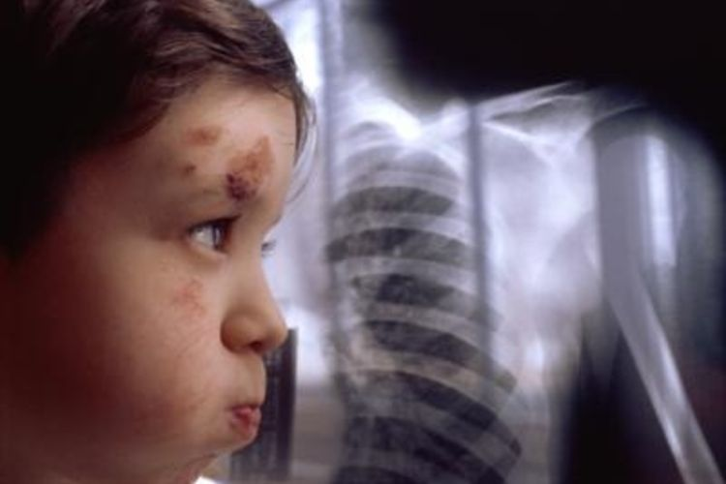
Types of Abuse: Physical
The child has suffered, or there is a substantial risk that the child will suffer, serious physical harm inflicted nonaccidentally upon the child by the child's parent or guardian. For the purposes of this subdivision, a court may find there is a substantial risk of serious future injury based on the way a less serious injury was inflicted, a history of repeated inflictions of injuries on the child or the child's siblings, or a combination of these and other actions by the parent or guardian that indicate the child is at risk of serious physical harm.

Slide 16
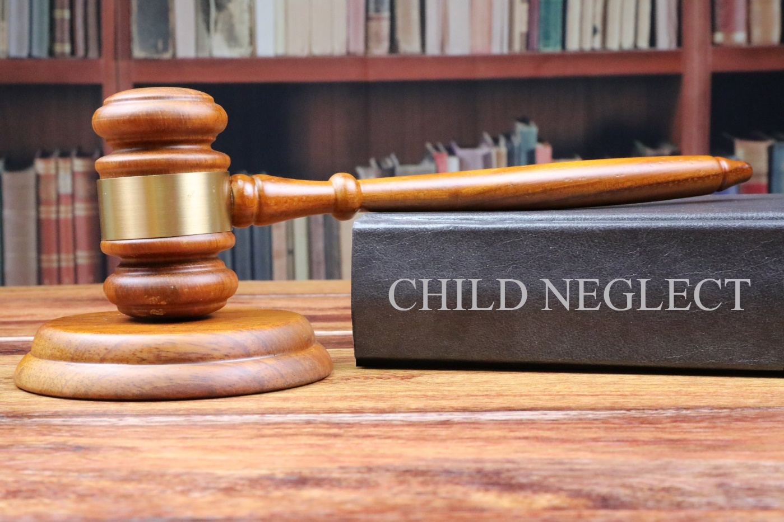
Types of Abuse: General Neglect
General neglect” means the negligent failure of a person having the care or custody of a child to provide adequate food, clothing, shelter, medical care, or supervision where no physical injury to the child has occurred but the child is at substantial risk of suffering serious physical harm or illness. “General neglect” does not include a parent's economic disadvantage.

Slide 17

Types of Abuse: Severe Neglect
“Severe neglect” means the negligent failure of a person having the care or custody of a child to protect the child from severe malnutrition or medically diagnosed nonorganic failure to thrive. “Severe neglect” also means those situations of neglect where any person having the care or custody of a child willfully causes or permits the person or health of the child to be placed in a situation such that their person or health is endangered as proscribed by Section 11165.3, including the intentional failure to provide adequate food, clothing, shelter, or medical care.

Slide 18
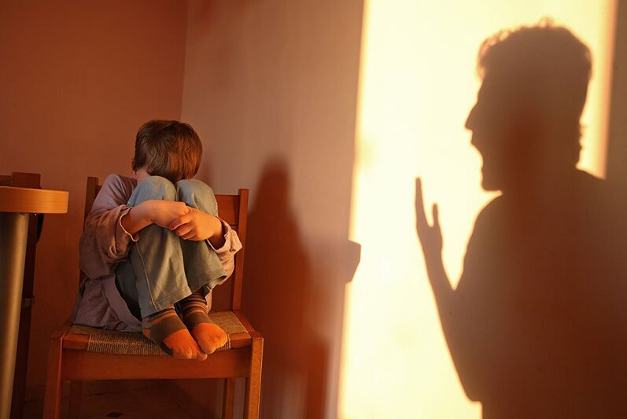
Types of Abuse: Emotional
A child is considered dependent if they are suffering serious emotional damage or are at substantial risk of suffering serious emotional damage, as evidenced by severe anxiety, depression, withdrawal, or untoward aggressive behavior toward self or others as a result of the conduct of the parent or guardian or who has no parent or guardian capable of providing appropriate care. No child shall be found to be a dependent person if the willful failure of the parent or guardian to provide adequate mental health treatment is based on a sincerely held religious belief and if a less intrusive judicial intervention is available.

Slide 19
Types of Abuse: Sexual
'Sexual assault' includes rape, incest, sodomy, lewd or lascivious acts upon a child, or child molestation.
'Sexual exploitation' refers to any of the following:
  Depicting a minor engaged in obscene acts; preparing, selling, or distributing obscene matter that depicts minors; employing a minor to perform obscene acts
  Knowingly permitting or encouraging a child to engage in, or assisting others to engage in, prostitution or a live performance involving obscene sexual conduct, or to either pose or model alone or with others for purposes of preparing a film, photograph, negative, slide, drawing, painting, or other pictorial depiction involving obscene sexual conduct
  Depicting a child in or knowingly developing, duplicating, printing, or exchanging any film, photograph, videotape, negative, or slide in which a child is engaged in an act of obscene sexual conduct

Slide 20
Small Group- 2 Vignettes THE SCAR
In your group, review your vignette & complete the SCAR.
Reminder: 1st call into the CPS hotline and talk to the Intake Social Worker.
2nd submit a SCAR within 36 of making the CPS hotline call. (if possible complete the SCAR prior to the call to have information organized)
Monterey County’s Child Abuse Hotline: 831 755 4661
After Hours: 831 755 4661
This line is open 24 hours a day/7 days a week!

Slide 21
Supermarket scar
You are working overtime on a Saturday. During your 15 minute break, you make a run to a nearby supermarket to grab a sandwich and a soda. While waiting in line, you recognize and woman and her young daughter, The woman, Nancy Newman, and her 7 year old daughter Brianna, live 3 doors down from you on Marvel Circle, in city of Farmtown, Ca.
They don’t notice you standing nearby, but you hear that Nancy is shouting at Brianna after Brianna asks if she can have a candy bar. You overhear Nancy telling Brianna she is “stupid” to think Nancy would buy her a candy bar because she is “enough of a fat pig,” and doesn’t need another “(expletive) candy bar.” You notice Brianna wipe a tear away as Nancy grabs their sandwich order and heads toward the checkout line. Your sandwich is ready around the same time, and you grab your order and make your way to the only checkout line open, just one customer behind Nancy and Brianna.
As the cashier gives Nancy her total, you overhear Nancy question the cashier, saying the amount is more than she estimated. It is then that Nancy notices Brianna snuck a candy bar into the cart when Nancy wasn’t looking. Nancy shouts angrily at Brianna, saying “I already told you! Enough with the (expletive) candy bars!” and she slaps Brianna so hard across the check, you can clearly see a red handprint on Brianna’s skin.
Nancy appears to be extremely frustrated, and you are worried, not only about Brianna’s safety, but about the safety of Brianna’s 9 month-old brother, Beau, and since you’re on duty, you know you are mandated to report the incident.

Slide 22
Parking lot -scar
You are an Eligibility Worker who has just conducted an interview with a mother, Sandra Slamponi, and her young son, Sonny (age 4). During the interview, you noticed that Sonny appeared to be unusually quiet and a little bit fearful. Sonny avoids eye contact with you when you offer him a coloring book. He sits quietly in the corner of the room. Sandra states Sonny is“very shy” around strangers, and attempts to rush through the interview, appearing flustered and embarrassed.
After the interview, you make a journal entry to document your interview, and you notice Sandra and Sonny in the parking lot. You have a clear view of Sandra a Sonny from the window in your interview room, and you notice Sandra appearing to shout angrily at Sonny.
After putting her purse and diaper bag in the trunk, you notice Sandra struggling to get Sonny into the car, as he stands crying next to the car door. You observe Sandra grabbing Sonny’s shoulders and violently shake him. When Sonny begins to cry harder, you notice Sandra backhand slap Sonny across the face, and shove him into the back of the car. Sandra locks the car doors and steps away from the vehicle to smoke a cigarette.
You call 911, but also know you need to make a mandated report. You make sure to provide Sandra’s contact information on the Suspected Child Abuse Report Form. Sandra’s cell phone number is 831 867 5309, and her address is 10025 Greengrass Lane, Farmtown, CA 12345.

Slide 23
Investigation Determination
Unfounded (Penal Code Section 11165.12)
Reports of suspected child abuse that are, upon investigation, found to be false, inherently improbable, are accidental injuries to a child or do not constitute child abuse at all.
Inconclusive (Penal Code Section 11165.12)
Reports of allegations of abuse in which, after gathering as much information as possible, there is still not enough evidence to clearly demonstrate that the child was abused, nor is there enough to say it was not abuse or accidental.
Substantiated (Penal Code Section 11165.12)
Reports of suspected child abuse that, after gathering credible relevant information, demonstrate that the child has been abused or neglected.

Slide 24
Structured Decision
Making!
You are all Child Welfare Social Workers. As a large group, use this vignette & the Structured Decision Making (SDM) Tool to assess & determine the appropriate response.
Answer the following questions:
What type of abuse or neglect is indicated in your vignette?
What is the appropriate response time? (24 hours, or 10 days)
Are there any preventative or voluntary services you might offer this family?

Slide 25
VIGNETTE- SDM
You are a teacher at Bluewater Elementary. You notice one of the students, Colt Coast (5), in your class has a mark under his right eye. He tells you that his mom hit him “because he was bad.” The child told you that he was hit three times on the cheek and on his eye with an open hand. You notice that there are two scratches about 2inches long, no bruising but you see under his eye it is pink in color. The child told you that it happened yesterday after school and you did not see any injuries when you saw the child in your class the day before.
You are concerned that the child was hit by the mother in the face hard enough that it caused an injury based on the child’s disclosure to you. As a mandated reporter, you make a report to the local CPS agency as soon as possible. You request support from office staff to locate the records and find a cell phone number for the mother, Margie Coast which is 831 888 1232.
You also take note of their home address: 78910 Mini Mountain Drive, Farmtown, CA 12345.

Slide 26
CSEC Tool: Categories & scoring
Commercially Sexually Exploitation Tool
l. HOUSING AND CAREGIVING
2. PRIOR ABUSE OR TRAUMA
3. PHYSICAL HEALTH AND APPEARANCE
4. ENVIRONMENT AND EXPOSURE
5. RELATIONSHIPS AND PERSONAL BELONGINGS
6. SIGNS OF CURRENT TRAUMA
7. COERCION
8. EXPLOITATION
Add scores for indicators 1 through 7 * If Indicator 8 score is 1 {Possible Concern) put 4 in Box B * If Indicator 8 is a 2 {Clear Concern) put 9 in Box B

Slide 27

Impact on the Mandated Reporter
Emotional
Fear that parent /caregiver will be angry & will take it out on you for reporting. Fear that co-worker will be angry
Denial
Fear of making a mistake.
Belief that nothing happens when you make a report, or that it makes things worse for the child and family
Do not believe the child
Secondary Trauma/Compassion Fatigue

Slide 28
Let’s review Our List and the first quiz
Name one thing you learned at today’s training you will share with peers.

Slide 29
Thank-you for joining us!
Child Abuse Mandated Reporter Training (mandatedreporterca.com)
FAX: (831)796-8529 or (831)755-8400
Monterey County’s Child Abuse Hotline: 831 755 4661
After Hours: 831 755 4661
SCAR link:
https://tinyurl.com/MontereySCAR
EVALUATION!

